Slide 1

CAPSTONE PROJECT
Smart Attendance Management Using Face Recognition

Slide 2
FINAL PROJECT
TEAM -83:
2003A52025 ETTADI NIKHILA
2003A52076 SURE VIVEK VARDHAN
2003A52119 NUKALA NARESH
2003A52015 SADU GOPI KRISHNA
2003A52037 KOTHA GANESH
Under the Guidance of
Mr. G. Sunil Reddy,
Assistant Professor, School of CS & AI,
SR University

Slide 3
Abstract:
This project uses facial detection in an attendance recorder system to track student attendance. Student faces are pre-stored in class databases.The Raspberry Pi camera captures student faces and compares them to database images. If they match, student attendance is recorded throughout time. Absentees' faces will be forwarded to their permitted email address.The Raspberry Pi is a credit card-sized computer or SoC with an ARM1176JZF-S core. System on a Chip (SoC) integrates all computer circuits into a single chip for efficient operation. The Raspberry Pi requires an operating system to boot up. To save money, the Raspberry Pi does not have any non-volatile memory on board.

Slide 4
Introduction :
Attendance tracking in institutions is crucial, typically done by teachers calling out names and students responding with their roll numbers, marking 'A' or 'P' in a log book. While this method is cost-effective and reliable, biometric options like RFID cards, fingerprints, or facial recognition are gaining traction. Biometric systems offer accuracy and efficiency but may be costly. An Automated Attendance Management System (AAMS) employing biometric tech simplifies tracking, enhancing accuracy and security. It automates marking, reduces manual work, and offers real-time insights. This paper explores AAMS's use cases, technical implementation, performance evaluation, and future enhancements, emphasizing its significance in modern attendance management.

Slide 5
Methodology
The suggested system offers a comprehensive key for automating attendance management in diverse organizations, mitigating the shortcomings of traditional manual methods. It operates on a subject-specific attendance calculation model. An administrator manually inputs student and subject data, and when it's a duration to a specific subject, the system automatically starts taking photos. Using an oriented gradient histogram to recognize faces and utilizing advanced learning methods to assess and contrast distinct facial attributes across 128 dimensions, the system recognizes individuals based on an existing database. It records the attendance of accredited students in real time and creates and saves an Excel table automatically.

Slide 6
Results
Results
The implementation and deployment of the Smart Attendance Management System (SAMS) using Raspberry Pi yielded significant results across various aspects, including system performance, user experience, and data accuracy.
The following sections outline the key results obtained from the SAMS implementation:
1) System Performance Evaluation: SAMS demonstrated real-time attendance marking capabilities, with minimal latency between facial recognition and attendance logging, ensuring timely and accurate data updates. The system exhibited scalability by efficiently handling a growing number of users and attendance records without compromising performance or response times.
2) System Performance Evaluation: The user interface of SAMS was well-received, providing an intuitive and user-friendly experience for administrators, instructors, and end-users.
Features such as search, filter, and export options enhanced user productivity and streamlined attendance management tasks.
3) Data Accuracy and Security: SAMS achieved high accuracy in facial recognition, accurately identifying individuals even in varying environmental conditions and facial expressions.
Implementation of data encryption, access control, and privacy measures ensured the security and confidentiality of attendance data, complying with relevant regulations.

Slide 7
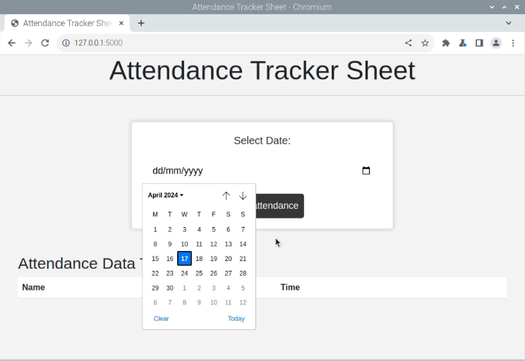
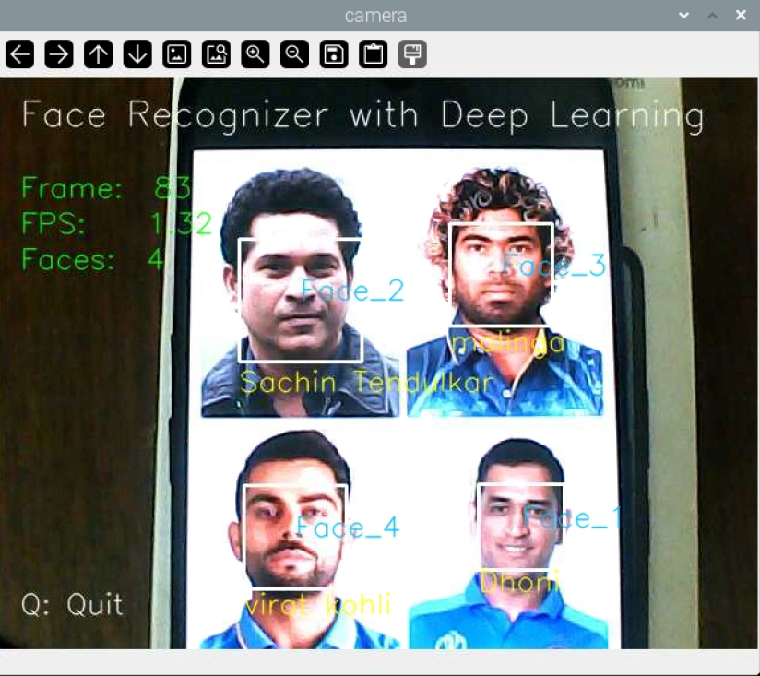
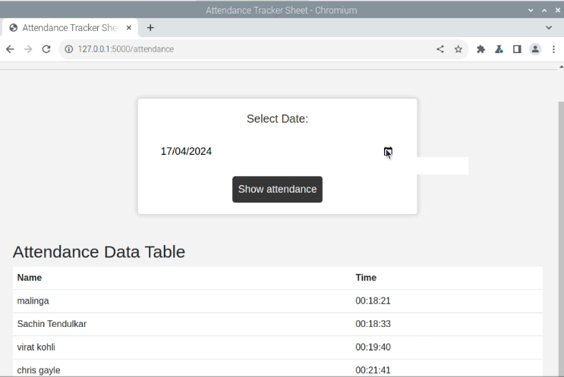

Slide 8
Conclusion:
The Smart Attendance Management System (SAMS) developed using Raspberry Pi has significantly improved the efficiency and accuracy of attendance tracking across various sectors. By automating attendance marking and leveraging biometric technology, SAMS has streamlined workflows, reduced manual errors, and provided real-time data insights. Its user-friendly interface and robust data security measures ensure a seamless user experience and data integrity. The project's impact extends to educational institutions for student attendance management and to businesses for employee tracking and compliance. Future enhancements could include advanced analytics integration, IoT expansion, cloud deployment for scalability, and continuous user feedback incorporation for further usability improvements. Overall, SAMS represents a transformative solution with immense potential for enhancing attendance management practices and decision-making processes.

